Slide 1
Giving Your Prototype The Edge
Jasmina Lazić, BSc, PhD
Application Engineering, MathWorks Inc.
MATLAB for Finance: From Research into Production
23rd April 2013

Slide 2
Agenda
Automated Trading in MATLAB
Modelling Counterparty Risk and CVA
Option Pricing with GPUs

Slide 3
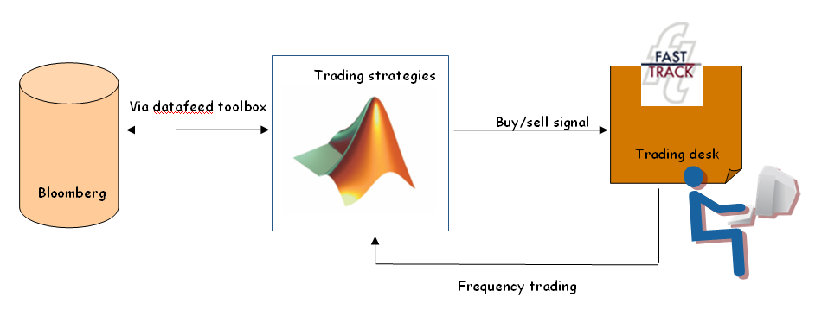
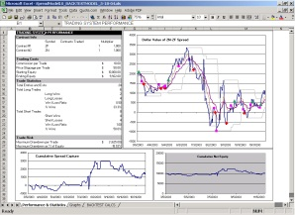
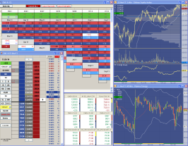




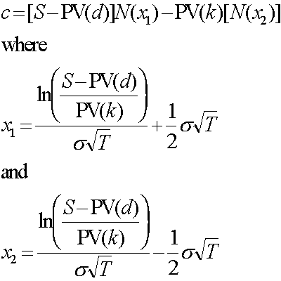
Desktop Trading Examples
Human-in-the-Loop
Challenges:
Multiple systems = cut and paste nightmare
Excel scalability limited and error prone
Limited “math” support for algos
Back testing is hard
Historical
Data
Desktop Algorithmic Trading
Challenges:
Algorithmic complexity increasing
Long development time
Limited “math” support for algos
Customization through programming
Back testing is hard
Historical
Data
Trading Strategy
(algorithm)
(C/C++, JAVA)
Monitoring
Performance
Notes:
Quants – developers of sophisticated trading models and tools
Traders – use quant tools or build simpler trading models themselves
Hil – someone bringing historical data, has a trading strategy (typically in Excel), that trading strategy may or may not be plugged in trading system directly. Then you have a trading strategy, but you have to cut and paste data and equations/calculations (Excel does not have XTRADER interface). There is not a lot of math in this case.
Desktop algorithmic trading system: you develop algorithm in C/C++ or Java, etc. Sometimes a trading platform itself may have a language. It allows you to take your algorithm, grab historical data, even live market data, make trading decisions and execute them on a trading platform. The trader himself can be monitoring multiple strategies at the same time and stop trading if something is going wrong. Development time can be long. Other pains are similar to the previous case.

Slide 4

Positioning MATLAB for Desktop Trading
Human-in-the-Loop
MATLAB Benefits:
Automation
Scalable (Parallel or MPS)
More “math”
Advanced visualization and back testing
Historical
Data
Desktop Algorithmic Trading
MATLAB Benefits:
Automation
Rapid prototyping to production
Scalable (Parallel or MPS)
Advanced visualization and back testing
Algo reuse across trading systems
Historical
Data
Trading Strategy
(algorithm)
Monitoring
Performance
Notes:
This slide shows where MATLAB fits in the Desktop Trading. We can see how the arrows change between different components. MATLAB has direct connection to Trading Technologies X_TRADER and Bloomberg. With ML you can automate processes, much more sophisticated libraries with advanced functionality – enables rapid prototyping, provides scalability in terms of number of algorithms you can run at the same time and the size of the problems.
The key takeaway: advanced visualisation and backtesting capabilities.
Trading TB allows reuse of algorithms across trading systems: if someone is using X_TRADER and someone else Bloomberg, ML can be used as a general trading platform. Take your algorithm and separate it from the trading system where it is used. The trading systems become more of an execution venue.

Slide 5
Trading Strategy Workflow prior to R2013a
Development and testing
Historical Data
Strategy Modeling
Back Testing
End of Day / Intraday
Research / Algorithms
Profit / Loss
Files
Model Development
Databases
Calibration
Risk Exposure
Live Trading
Live Data
Decision Engine
Execution
Real-Time Feeds
Models
Broker API
Event-Based
Trading Rules
Order Routing
Lack trading system integration!

Slide 6
Trading Strategy Workflow R2013a
Development and testing
Historical Data
Strategy Modeling
Back Testing
End of Day / Intraday
Research / Algorithms
Profit / Loss
Files
Model Development
Databases
Calibration
Risk Exposure
Live Trading
Live Data
Decision Engine
Execution
Real-Time Feeds
Models
Broker API
Event-Based
Trading Rules
Order Routing
Market Access
(via Trading Toolbox)
Notes:
Traders take historical data, they develop a trading strategy in ML, they backtest it and look at the profit/loss and risk exposure. When you want to implement this into a live trading system, you need to connect to live data feed, the decision engine makes the decision for you and then execution venue: sending the trade to some place where it can be executed.
The wall is now removed: now we have complete connectivity to the real market data from exchanges, as well as the execution system. When you are trading, you need to know what is the exact current price that you are trading against. Datafeed TB gives you consolidated feeds from exchanges - the current price across many markets with Thomson Reuters or Bloomberg.

Slide 7
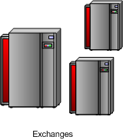
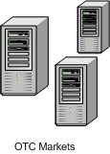
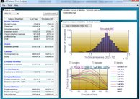
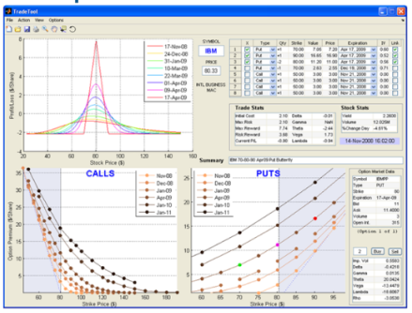
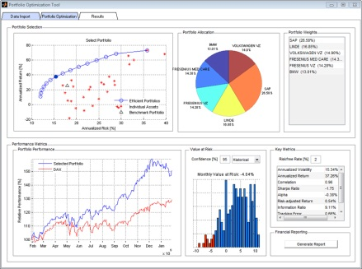
What does Trading Toolbox do?
Market Access
Trading Toolbox
X_Trader
Bloomberg EMSX
Bloomberg EMSX
Risk Engine
Pricing Engine
Trading Engine
Financial Toolbox
Fin. Instruments Tbx
Financial Toolbox
Statistics Toolbox
Financial Toolbox
Optimization Toolbox
Notes:
What does the Trading TB REALLY do? Allows you to connect ML (your algorithms) to 2 different exchanges: public exchanges and on-the-counter: from investor to investor or large bank to large bank, usually trading more customised deals. Trading TB allows you to trade on both markets (with X_TRADER and Bloomberg EMSX). Bloomberg EMSX supports all kinds of brokers, so you can trade to your preferred broker.
3 types of trading applications:
Risk engine (risk manager). Looking at minimizing the risk of operations of an organization. They would trade instruments to hedge other instruments, or warn portfolio manager of exposure.
Pricing Engine. How to price things in OTC market with a low liquidity? They use algorithms to estimate what the price is and make decision whether to buy/sell. (e.g. a property)
Trading Engine. Portfolio you are looking to manage and use different trading strategies.

Slide 8
Counterparty Credit Risk
The risk that a counterparty will not honour its contractual obligations
Like defaulting on a loan
Was often ignored pre-2008
Can be hedged with credit insurance
This value is quantified by Credit Value Adjustment (CVA)
We have based this talk loosely around the paper: “A Guide to Modelling Counterparty Credit Risk”, Global Association of Risk Professionals (37), Pythkin and Zhu, 2007
Notes:
CVA expected loss of an OTC instrument due to counterparty default

Slide 9
Counterparty Credit Risk (CCR) Workflow
Inputs
Inputs:
Risk factors data, portfolio data, dates of interest, and netting
Simulation:
Potential future ‘scenarios’, simulation of risk factors, valuation of portfolio instruments, create valuations “cube”
Exposure analysis:
Exposures aggregation with netting and collateral info, profiles (EE, EPE, etc.), plots and reports
Simulation
Exposure
Analysis
Default
Probability
Credit
Value
Adjustment
Notes:
The credit exposure of a bank that has a single derivative contract with a counterparty is the maximum of the contract’s market value and zero.
A netting agreement is a legally binding contract between two counterparties that, in the event of default, allows aggregation of transactions between two counterparties – i.e., transactions with negative value can be used to offset the ones with positive value and only the net positive value represents credit exposure at the time of default.
EE = expected exposure, EPE = expected positive exposure
Hull-White model: Hull–White model is a model of future interest rates.
The scenarios are usually specified via stochastic differential
equations (SDE). Typically, these SDEs describe Markovian
processes and are solvable in closed form. For example, a
popular choice for modelling FX rates and stock indices is
the generalized geometric Brownian motion.

Slide 10
Modelling CCR in MATLAB: An Example
Setup:
Portfolio of interest rate swaps
Valuation dates every 6 months
Risk factors are interest rates
Simulate “cube” of instrument
values
One row per swap in the portfolio
One column per valuation date
One “page” per scenario
Generate exposure profiles at different levels
Compute CVA for one counterparty
Instruments
Scenarios
Valuation Dates

Slide 11
Simulation: Main Iteration
Yield
Scenario
Tenor
Simulation Time
MtM
Swap
Simulation Time
Coupon Dates
Valuation Dates
Notes:
MtM = market to market

Slide 12
Partitioning a Large Scale Valuation “Cube”
By scenarios only
By scenarios and subportfolios
Instruments
Instruments
Scenarios
Scenarios
Valuation Dates
Valuation Dates

Slide 13
MATLAB Tools for CCR
Exposures
Inputs: Database, Datafeeds, Financial (fts, dates)
Simulation: Statistics (models, multivariate, calibration, random numbers), Econometrics (models, SDEs), Financial Instruments (valuation models, calibration), MATLAB (objects, vectorization, logical indexing, etc.)
Exposure profiles: MATLAB (matrices, vectorization, logical indexing, plots)
Credit Value (Valuation) Adjustment (CVA)
Default probability calibration: Financial Instruments(CDS)
CVA computation: MATLAB (sums, integration), Financial Instruments (CDS)

Slide 14
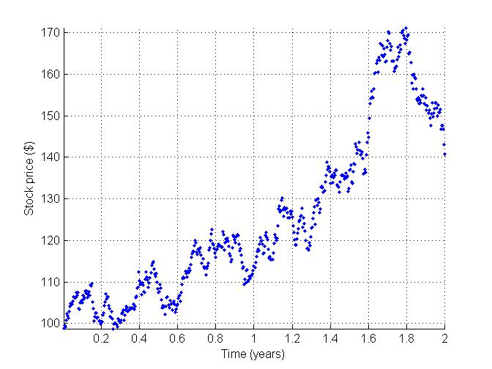
Option Pricing with GPUs
Monte Carlo simulations of a Stochastic Differential Equation
Takes advantage of GPU hardware in a straightforward manner
Notes:
For Asian options the payoff is determined by the average underlying price over some pre-set period of time. This is different from the case of the usual European option and American option, where the payoff of the option contract depends on the price of the underlying instrument at exercise; Asian options are thus one of the basic forms of exotic options.

Slide 15
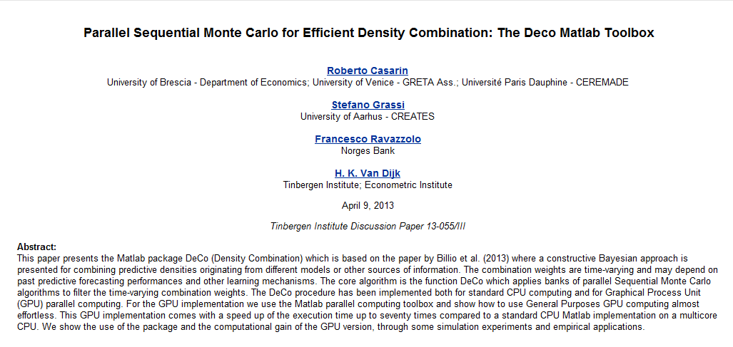
Another Example of Using GPUs with MATLAB
Notes:
Example of 70 times speed-up with GPUs, compared to CPUs.

Slide 16
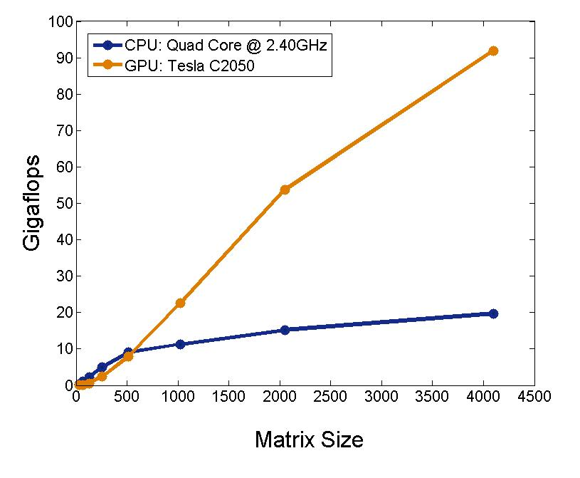
Performance: A\b with Double Precision

Slide 17



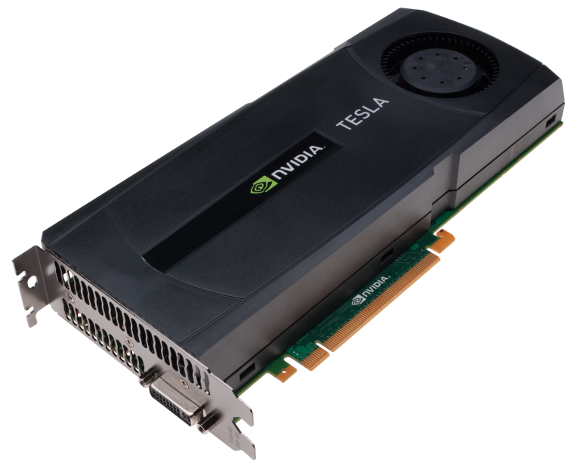


Parallel Computing with MATLAB
Parallel Computing
Toolbox
MATLAB Distributed
Computing Server
MATLAB Workers
…
User’s Desktop
Compute Cluster
Notes:
This slide is a high-level overview of the parallel computing tools.
The MATLAB membrane → This is you, sitting at your desktop (or laptop) with your MATLAB open.
*Click*
With Parallel Computing Toolbox, it allows you to start up a pool of MATLAB workers to distribute your work. The toolbox allows you to open up to 8workers, and on a multi-core machine, you can fully utilize your cores. You can think of these workers as “head-less” MATLABs which you can control with your client MATLAB.
The nice thing about this set up is that if you ever want to scale up to a cluster environment,
*Click*
the same Parallel Computing Toolbox can be used to communicate to MATLAB workers that reside on external networked computers. In this scenario, the workers are installations of MATLAB Distributed Computing Server. But the user can interact with the external MATLAB workers the same way they interact with the internal MATLAB workers

Slide 18
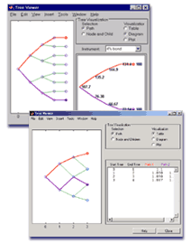
Some common pricing & valuation methods
Monte Carlo/quasi Monte Carlo simulation; SDEs
Closed form solutions
e.g., Black Scholes, Black 67
Tree based methods
e.g., binomial, trinomal trees
Finite Differences
Notes:
Each has their trade-offs:
Which is best?
Accuracy
Evaluation speed
Implementation speed
Robustness
Generality
Simplicity

Slide 19
Summary
Number of sophisticated MATLAB tools to help you perform specific financial tasks (Trading, Statistics, Financial, Financial Instruments, Econometrics, Parallel Computing, etc.)
Speeding up your computations using multicores, GPUs, cloud

